Slide 1

IT SOLUTION FOR NIKE JUST DO IT
presented by
SEJAL SINGH
REVA UNIVERSITY

Slide 2

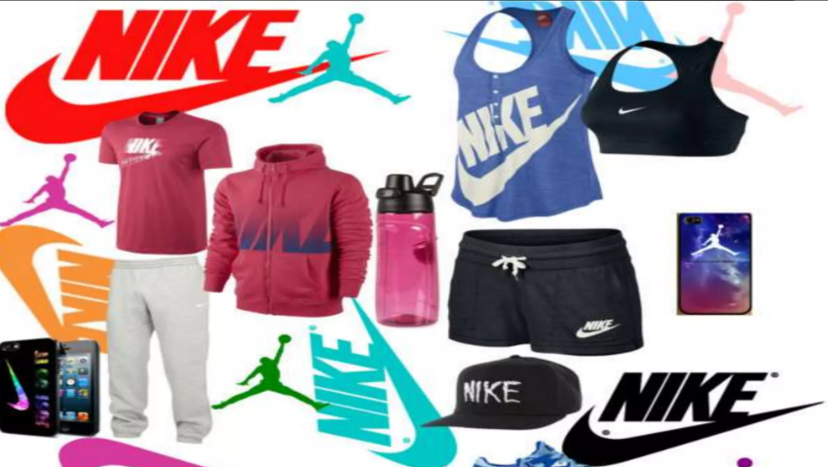
Agenda
1. What is Nike？
2. Challenges on documentaion
3. Proposal of IT solution
4. How to proceed the project
5. Appendix

Slide 3
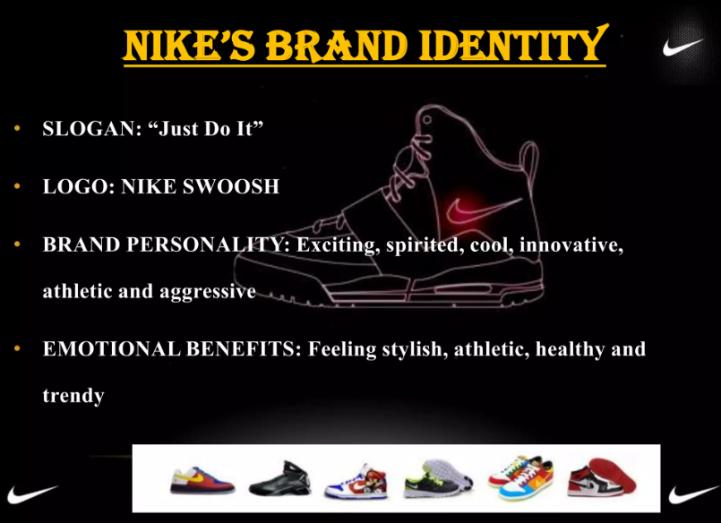
What is Nike?
Nike is a globally renowned and iconic sportswear, footwear, and athletic equipment company that has established itself as a leader in the athletic apparel industry. Founded in 1964 by Bill Bowerman and Phil Knight, the company originally operated under the name Blue Ribbon Sports. It later rebranded as Nike in 1971, taking its name from the Greek winged goddess of victory.
Nike is known for its commitment to innovation, quality, and cutting-edge design. The company's primary focus is on producing athletic footwear, apparel, and accessories that cater to a wide range of sports and activities. Nike's products are widely recognized for their performance-enhancing features, comfort, and distinctive designs that often incorporate the iconic Nike Swoosh logo.
Nike's impact goes beyond just its products; it has been a pioneer in championing social and environmental initiatives. The company has advocated for diversity, inclusion, and sustainability, aligning its business practices with responsible and ethical values.
With a presence in multiple countries and a wide network of retail stores and online platforms, Nike continues to shape the athletic and fashion industry landscape by delivering innovative and high-quality products that inspire individuals to "Just Do It" and push their limits.

Slide 4
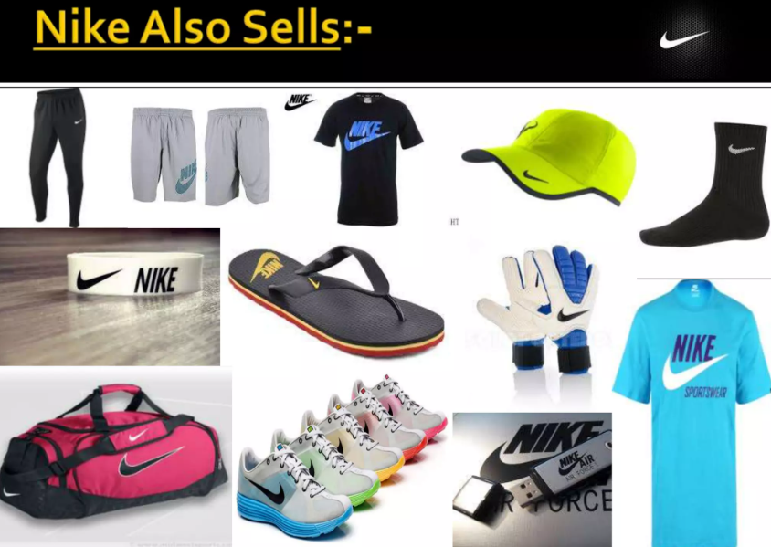
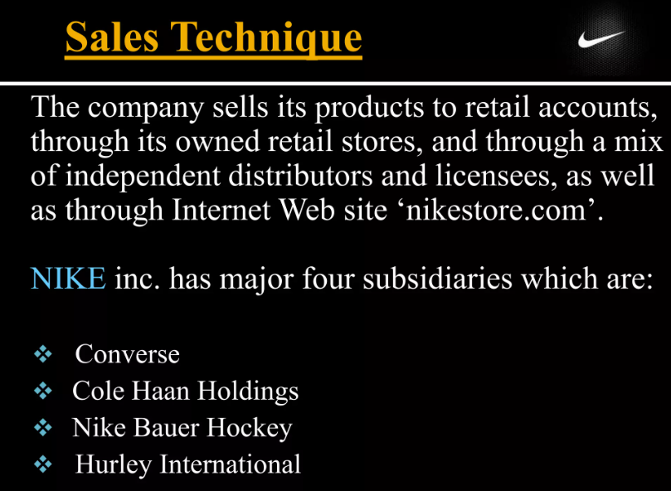
Challenges in Documentation at Nike
Effective documentation is a crucial aspect of any company's operations, including a global brand like Nike. Despite its success, Nike faces several challenges related to documentation in its various processes. Some of these challenges include:
Custom Sneaker Design Records:
Nike's custom sneaker design process involves intricate customization options for customers. Documenting these design specifications accurately and comprehensively can be challenging, leading to discrepancies between the customer's vision and the final product.
Manufacturing Workflow Documentation:
Documenting the complex workflow of custom sneaker manufacturing, from design to production, can be intricate. Ensuring that each step is accurately recorded while accounting for variations due to customization requires meticulous documentation.
Communication with Manufacturers:
Effective communication with manufacturing partners is crucial to ensure that custom designs are accurately translated into physical products. Documenting design changes, specifications, and production updates in a clear and organized manner can be demanding, especially when dealing with a global supply chain.
Quality Control Documentation:
Maintaining consistent quality across custom sneaker designs requires thorough quality control. Documenting quality assurance processes, identifying defects, and tracking improvements can be complex, especially given the diverse range of customizations.
Customer Interactions and Feedback:
Documenting customer interactions, feedback, and preferences is essential for refining custom sneaker offerings. Managing and analyzing customer data, while maintaining data privacy and security, can be a challenge.

Slide 5
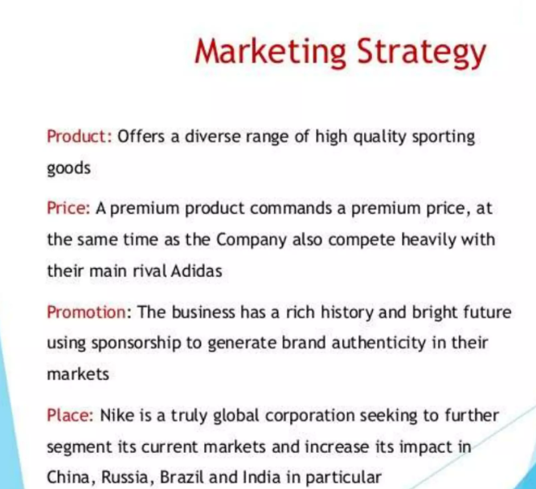
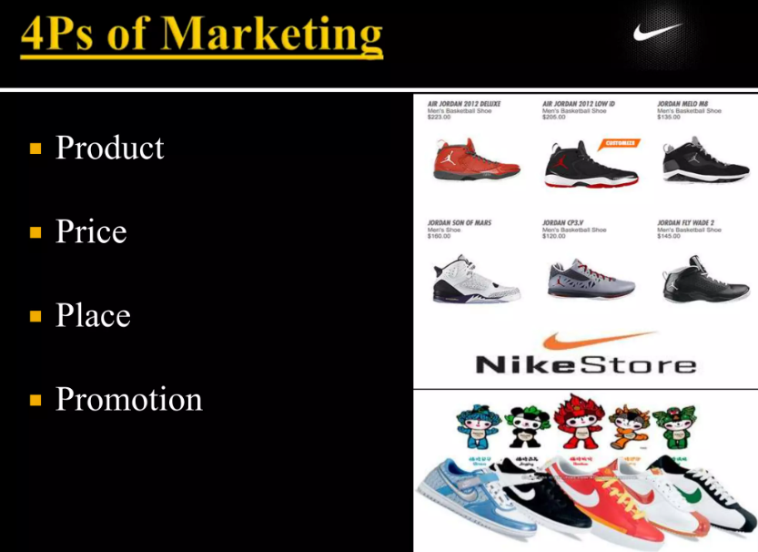
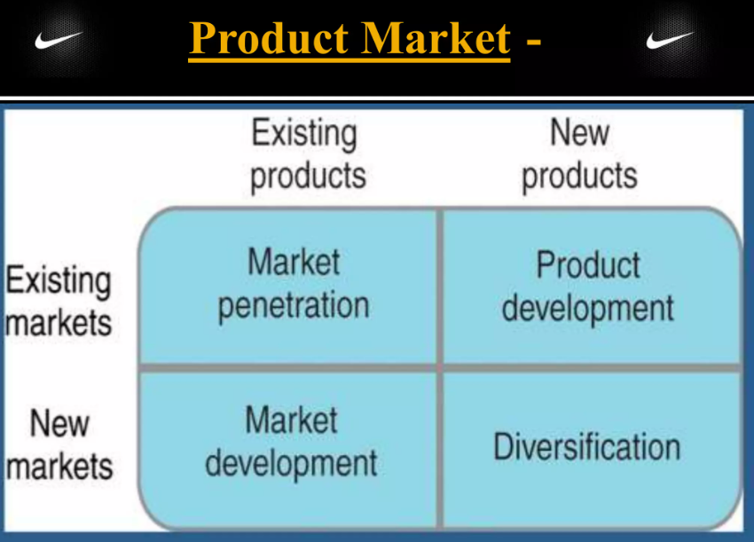
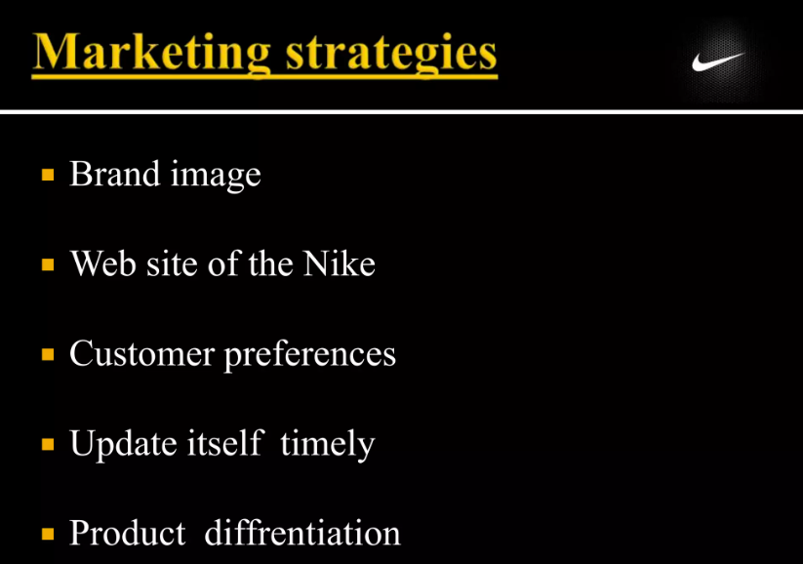
Addressing Challenges through IT Solutions:
To tackle these challenges, Nike can implement a comprehensive IT solution that integrates advanced design tools, real-time communication platforms, automated quality control tracking, and centralized documentation management systems. By leveraging technology, Nike can streamline its documentation processes, improve accuracy, enhance collaboration, and ensure that each custom sneaker design is documented accurately from inception to production.

Slide 6
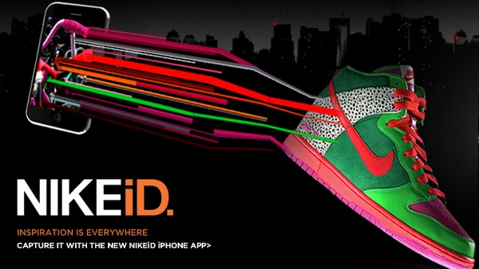
Proposal of IT Solution for Enhancing Nike's Custom Sneaker Design Process
Nike's custom sneaker design process presents unique challenges that can be effectively addressed through a comprehensive IT solution. The proposed solution, the Enhanced Custom Sneaker Design and Manufacturing System (ECSDMS), leverages cutting-edge technology to streamline design, manufacturing, and documentation processes, while enhancing customer experiences. Below is a detailed proposal of the IT solution:
Integrated Design Platform: Develop a user-friendly online platform that offers an intuitive interface for customers to design their custom sneakers. Incorporate 3D design tools, allowing customers to visualize their creations in real-time. This platform would enable customers to choose materials, colors, patterns, and even upload personalized graphics.
Augmented Reality (AR) Try-On Feature: Integrate an AR try-on feature within the platform, enabling customers to virtually try on their custom designs using their smartphone cameras. This feature allows customers to see how the sneakers fit and look in the real world, enhancing their confidence in design choices.
Automated Design Feedback and Suggestions: Implement AI-driven algorithms that analyze customer design preferences and offer design suggestions based on trends and compatibility. This assists customers in refining their designs and fosters a personalized design experience.
Real-time Communication with Manufacturers: Develop a secure communication platform that connects customers, designers, and manufacturers in real-time. This ensures that design specifications, updates, and modifications are communicated seamlessly, reducing errors and delays.
Automated Quality Control Tracking: Integrate IoT devices and sensors in the manufacturing process to monitor quality metrics in real-time. Any deviations from quality standards trigger immediate alerts, allowing corrective actions to be taken promptly.
Centralized Documentation Management System: Implement a centralized document management system that records every stage of the design and manufacturing process. This system ensures that design specifications, communication logs, quality control data, and customer interactions are accurately documented and easily accessible.
Data Analytics for Continuous Improvement: Utilize data analytics to gather insights from customer interactions, design trends, and manufacturing processes. This data-driven approach helps Nike make informed decisions to optimize design offerings and manufacturing efficiency.
User Training and Support: Offer comprehensive training resources and user support to designers, manufacturers, and customers. User guides, video tutorials, and a responsive customer support team ensure smooth adoption and utilization of the ECSDMS.
Data Privacy and Security Measures: Implement robust data privacy and security measures to safeguard customer data, design specifications, and sensitive information throughout the entire design and manufacturing journey.
The ECSDMS offers a holistic solution that enhances the entire custom sneaker design process, from concept to production. By embracing advanced technologies, Nike can significantly improve design accuracy, manufacturing efficiency, and customer satisfaction. This IT solution aligns with Nike's commitment to innovation and excellence, placing it at the forefront of the custom sneaker market.

Slide 7
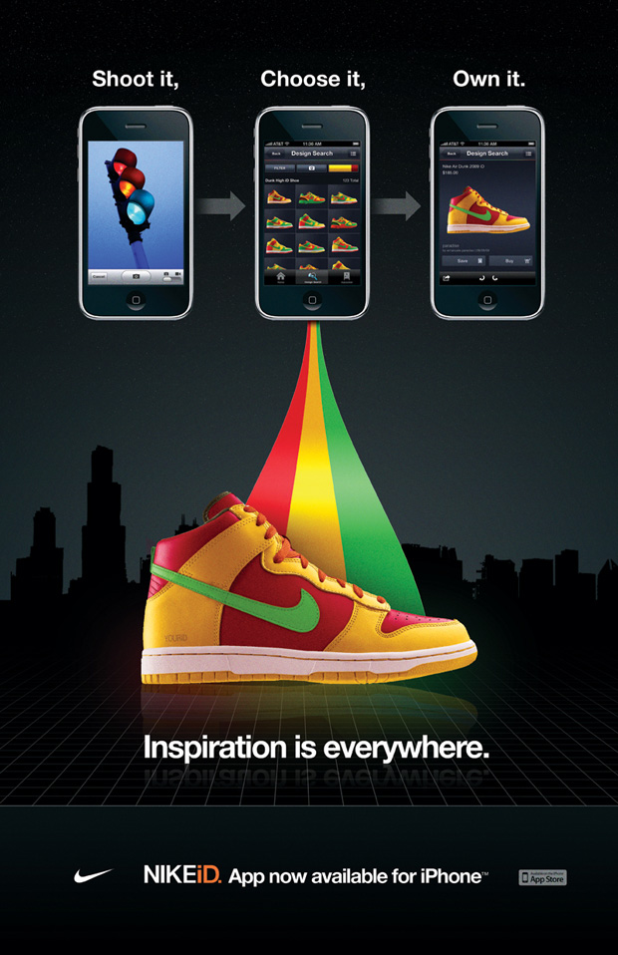
User Interface for Nike's Enhanced Custom Sneaker Design Platform
A user-friendly and visually appealing user interface (UI) is essential for Nike's enhanced custom sneaker design platform. The UI should seamlessly guide customers through the design process, provide clear information, and ensure an enjoyable and intuitive experience. Here's an overview of the proposed user interface elements:
Landing Page:
Engaging welcome screen showcasing Nike's brand identity and custom sneaker options.
Clear call-to-action buttons encouraging users to start designing their sneakers.
Custom Design Studio:
Interactive canvas where users can choose sneaker model, colors, materials, and design elements.
Intuitive drag-and-drop functionality for adding graphics, logos, and patterns.

Slide 8
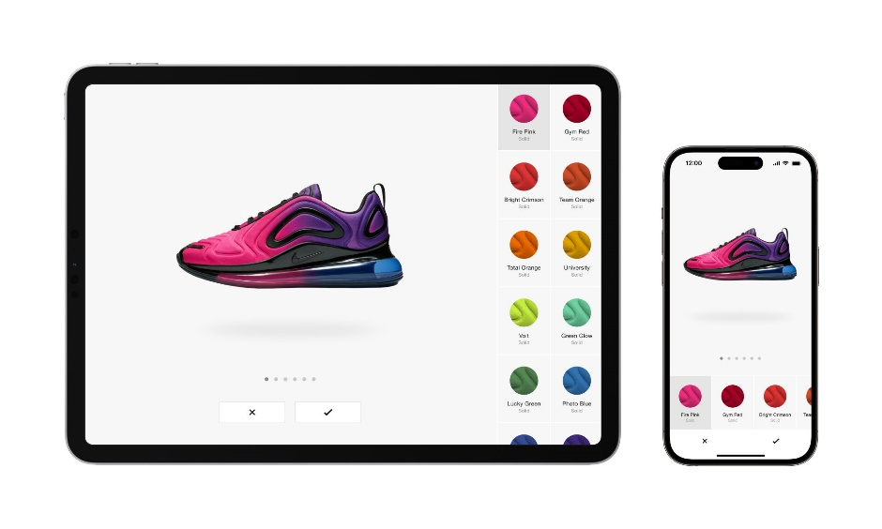
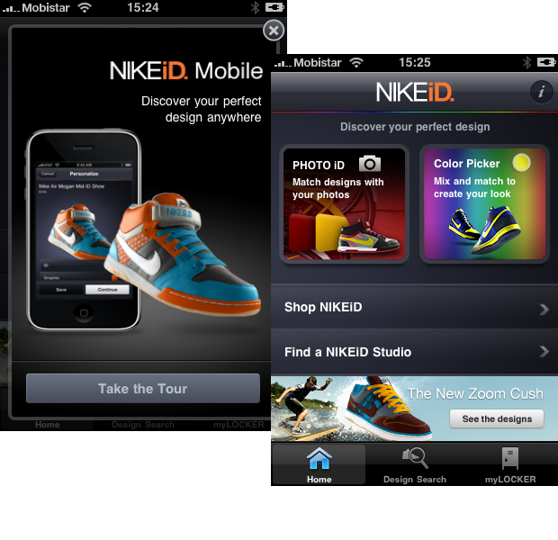
User Interface for Nike's Enhanced Custom Sneaker Design Platform
3D Sneaker Visualization:
Realistic 3D rendering of customized sneakers that users can rotate, zoom in, and inspect from various angles.
Ability to switch between different views, such as top, side, and back.
AR Try-On Feature:
Option to virtually "try on" designed sneakers using AR technology.
Users can use their smartphone cameras to see how the sneakers would look on their feet.
Sizing Assistance:
Step-by-step instructions for accurate foot measurement using the mobile app.
Clear visual cues and guidelines to ensure precise sizing.

Slide 9
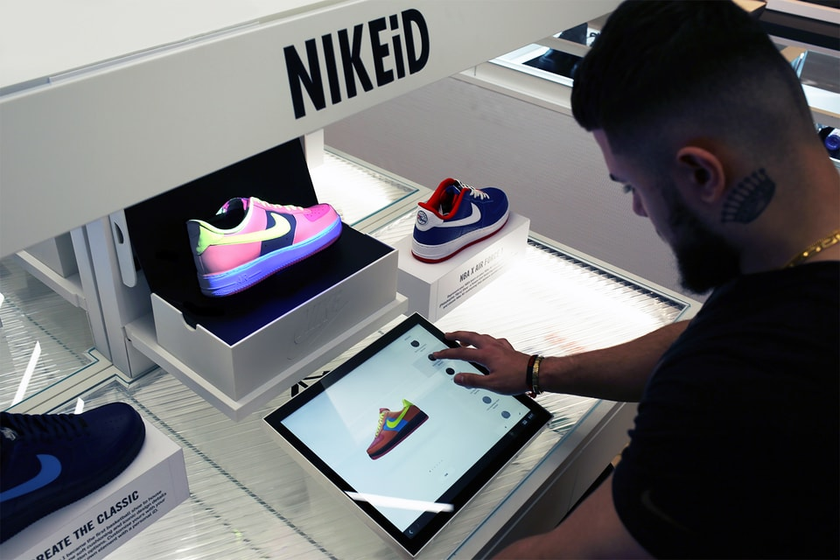
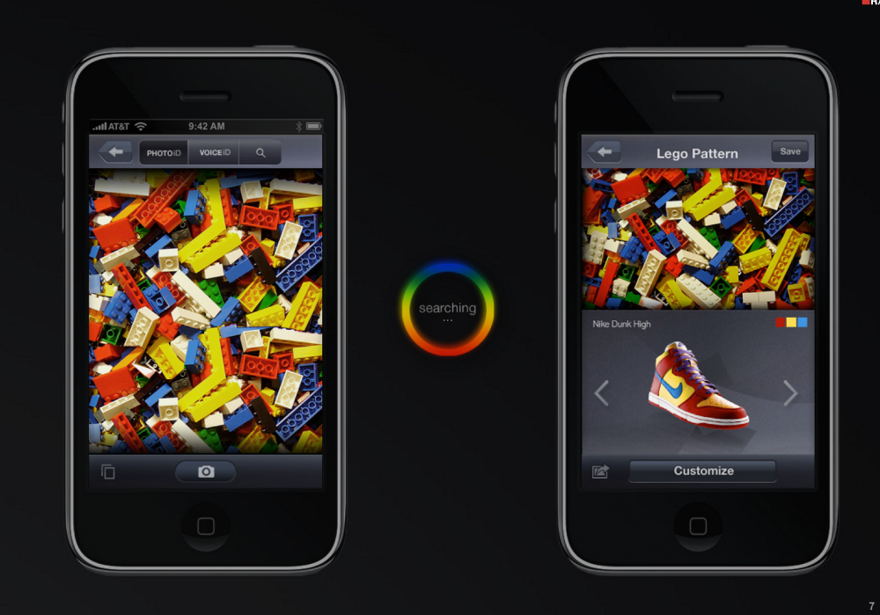
User Interface for Nike's Enhanced Custom Sneaker Design Platform
Personalization Options:
Dropdown menus and color palettes for selecting customization options.
Text input fields for adding personalized messages or names on the sneakers.
Real-Time Price Calculation:
Dynamic price calculator that updates in real-time based on selected options.
Breakdown of costs for materials, design complexity, and customization choices.
Collaboration and Sharing:
Collaboration features allowing users to share their designs with friends and family for feedback.
One-click sharing buttons for social media platforms.
Order Tracking Dashboard:
User account dashboard showing the status of ongoing orders and past purchases.
Real-time updates on the manufacturing progress of custom sneakers.
Help and Support Center:
Access to FAQs, video tutorials, and customer support chat for assistance.
Clear contact information for reaching out to Nike's customer service.
Secure Checkout:
Seamless and secure checkout process for finalizing orders.
Multiple payment options and a summary of the design choices before purchase.

Slide 10
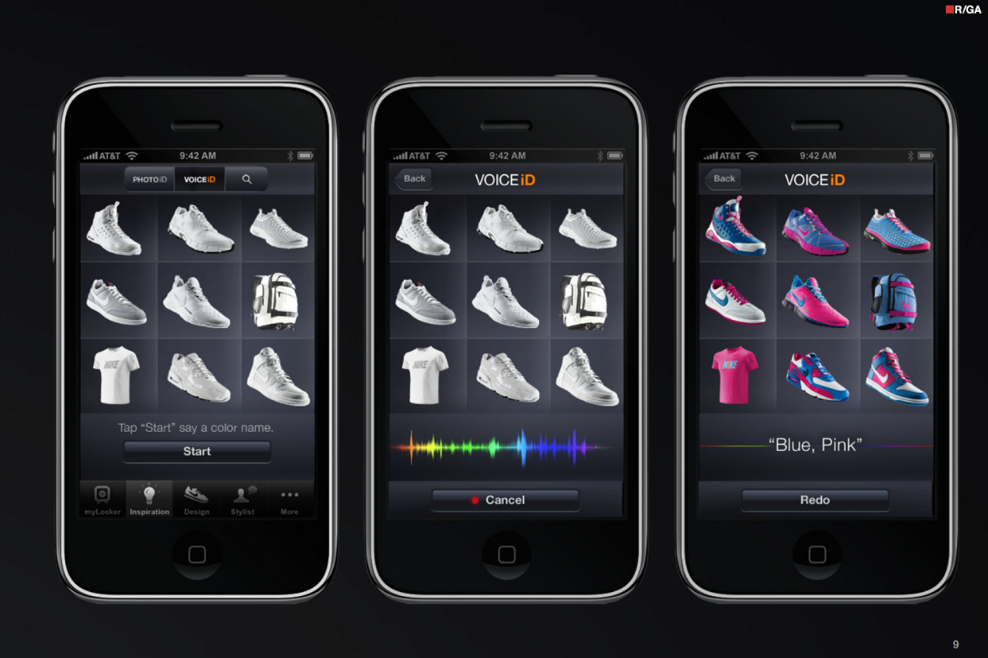
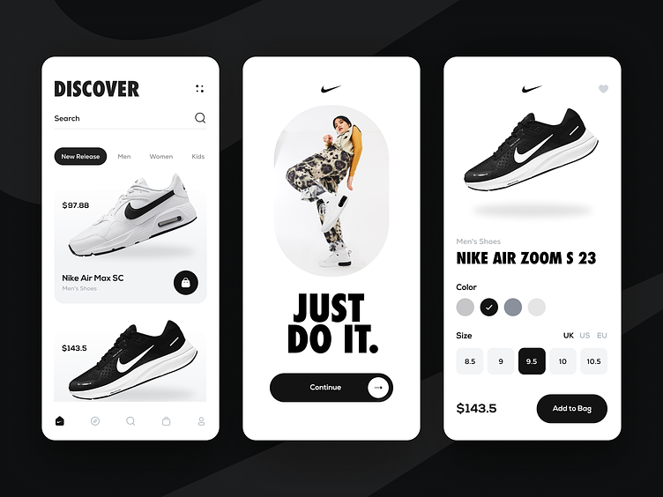
User Interface for Nike's Enhanced Custom Sneaker Design Platform
Visual Design Guidelines:
Consistent use of Nike's brand colors, typography, and visual elements.
Minimalist design that emphasizes the sneaker visuals and customization options.
Responsive Design:
Ensuring the platform is accessible and user-friendly across various devices, including desktops, tablets, and smartphones.
By incorporating these UI elements, Nike can provide an immersive and enjoyable custom sneaker design experience for its customers, fostering engagement, satisfaction, and a stronger connection to the brand.

Slide 11
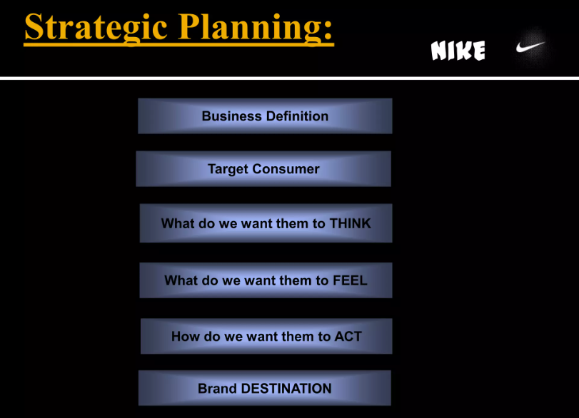
How to Proceed with the IT Solution Project for Nike's Custom Sneaker Design Enhancement
Implementing the proposed IT solution for enhancing Nike's custom sneaker design process requires careful planning, collaboration, and execution. Here's a step-by-step approach to proceed with the project:
1. Project Kick-off and Stakeholder Alignment:
Gather key stakeholders, including design teams, IT experts, manufacturing personnel, and customer support representatives.
Present the project proposal, emphasizing the benefits of the IT solution in improving customer experience and operational efficiency.
2. Requirements Gathering and Analysis:
Collaborate with design teams to define detailed requirements for the custom sneaker design platform, AI algorithms, AR features, and other components of the solution.
Conduct a comprehensive analysis of existing processes to identify pain points and opportunities for improvement.
3. Solution Design and Architecture:
Work with IT experts to design the technical architecture of the solution, including database structures, API integrations, user interfaces, and security measures.
Create wireframes and prototypes to visualize the user experience and gather feedback from stakeholders.
4. Development and Testing:
Begin development of the custom sneaker design platform, AI algorithms, AR app, and other components according to the design specifications.
Conduct thorough testing to ensure the solution's functionality, usability, and security meet the project's objectives.
5. Collaborative Platform Integration:
Integrate real-time collaboration features that connect customers, designers, and manufacturers. Enable seamless communication and feedback exchange.

Slide 12
How to Proceed with the IT Solution Project for Nike's Custom Sneaker Design Enhancement
7. Data Management and Privacy Compliance:
Establish secure data management protocols and ensure compliance with data privacy regulations to protect customer information.
8. AR Try-On App Development:
Develop the augmented reality app that enables customers to virtually try on their custom-designed sneakers. Test the app for accuracy and user experience.
9. User Training and Support:
Prepare user guides, tutorials, and training materials for designers, manufacturers, and customer support teams to ensure smooth adoption of the new system.
10. Testing and Iteration: - Conduct comprehensive testing of the entire solution, including the custom sneaker design platform, AR app, collaboration features, and automated processes. - Gather feedback from stakeholders and make necessary iterations to enhance functionality and usability.
11. Rollout and Adoption: - Gradually roll out the solution to a select group of users for initial testing and feedback. - Monitor adoption rates and gather insights to address any challenges or concerns.
12. Full-Scale Implementation: - After successful testing and iteration, launch the solution on a larger scale, making it available to all customers interested in custom sneaker designs.
13. Monitoring and Continuous Improvement: - Continuously monitor the solution's performance, gather user feedback, and identify areas for further enhancement. - Use data analytics to gather insights and make data-driven improvements to design offerings and manufacturing processes.
By following this structured approach, Nike can successfully implement the IT solution to enhance its custom sneaker design process. Effective project management, collaboration, and a commitment to innovation will be key factors in achieving the project's objectives and ensuring a seamless customer experience.

Slide 13
Challenges and Directions for Solutions in Enhancing Nike's Custom Sneaker Design Process
Challenge 1: Design Accuracy and Communication
Challenge: Ensuring accurate translation of customer design preferences from concept to production, leading to potential design discrepancies and customer dissatisfaction.
Solution: Implement a collaborative online platform that allows customers, designers, and manufacturers to communicate in real time. This platform should include features for uploading design visuals, sharing feedback, and visualizing design changes in a virtual environment.
Challenge 2: Sizing Precision and Fit
Challenge: Inaccurate foot measurements provided by customers leading to ill-fitting custom sneakers.
Solution: Develop a mobile app equipped with augmented reality (AR) capabilities that guide customers through accurate foot measurements. The app should generate precise measurements for customized sizing.
Challenge 3: Design Visualization
Challenge: Customers struggle to visualize how selected design elements will come together in the final product.
Solution: Integrate a 3D modeling and rendering tool into the custom sneaker design platform. This tool enables customers to see a detailed and realistic visual representation of their design choices.
Challenge 4: Manufacturing Transparency
Challenge: Lack of transparency regarding the manufacturing progress of custom sneakers, leading to customer uncertainty and inquiries.
Solution: Incorporate IoT devices and real-time tracking mechanisms into the manufacturing process. This provides customers with real-time updates on their custom sneaker's production stages.

Slide 14
Challenges and Directions for Solutions in Enhancing Nike's Custom Sneaker Design Process
Challenge 5: Quality Consistency
Challenge: Maintaining consistent quality across custom sneaker orders with varying design complexities.
Solution: Integrate machine learning algorithms to analyze manufacturing data and identify patterns related to quality deviations. This proactive approach ensures that quality benchmarks are consistently met.
Challenge 6: Data Privacy and Security
Challenge: Ensuring the security and privacy of customer data, especially when collecting personal information for custom sizing.
Solution: Implement robust data encryption and secure storage protocols to protect customer data. Adhere to data privacy regulations and obtain customer consent for data usage.
Challenge 7: User Adoption and Training
Challenge: Ensuring that customers, designers, and manufacturers effectively adopt and utilize the new IT solution.
Solution: Provide comprehensive user training materials, tutorials, and customer support resources. The platform's user interface should be intuitive and user-friendly.
Challenge 8: Technical Integration
Challenge: Integrating various technologies, such as AR, AI, and IoT, seamlessly into the custom sneaker design process.
Solution: Collaborate with technology partners and experts in each field to ensure a smooth integration process. Conduct thorough testing to identify and address potential technical glitches.
Challenge 9: Design Recommendations
Challenge: Customers may struggle with making design decisions, leading to decision fatigue and delayed purchases.
Solution: Integrate AI-driven design recommendation features that analyze customer preferences and suggest design elements based on trends and personal style.
Challenge 10: Scalability
Challenge: Ensuring that the IT solution can accommodate the growing demand for custom sneakers without sacrificing quality or customer experience.
Solution: Design the IT solution with scalability in mind, utilizing cloud-based infrastructure and agile development practices. Continuously monitor performance and optimize as needed.
Addressing these challenges through the proposed solutions will enhance Nike's custom sneaker design process, improving customer satisfaction, operational efficiency, and brand loyalty.

Slide 15

Problems and solutions
Problem 1: Nike faces challenges in managing its supply chain. The company has a large and complex supply chain, with suppliers located all over the world. This makes it difficult to track inventory, ensure quality control, and meet demand.
IT Solution: Nike can use a supply chain management (SCM) system to improve the efficiency and visibility of its supply chain. A SCM system can help Nike to track inventory levels, forecast demand, and manage supplier relationships. This can help Nike to reduce costs, improve customer service, and avoid stockouts.
Problem 2: Nike also faces challenges in ensuring the ethical sourcing of its products. The company has been criticized for using sweatshops and other unethical labor practices.
IT Solution: Nike can use a blockchain platform to track the ethical sourcing of its products. A blockchain platform is a secure and transparent way to record data. Nike can use a blockchain platform to track the movement of its products from the raw materials stage to the finished product stage. This can help Nike to ensure that its products are sourced ethically.
Problem 3: Nike faces challenges in marketing its products to a global audience. The company needs to be able to customize its marketing campaigns to different cultures and markets.
IT Solution: Nike can use an artificial intelligence (AI) platform to personalize its marketing campaigns. An AI platform can help Nike to understand the needs and interests of its customers. This can help Nike to create more relevant and effective marketing campaigns. These are just a few examples of IT solutions that Nike can use to solve the problems it faces. By investing in IT, Nike can improve its efficiency, sustainability, and customer service.

Slide 16
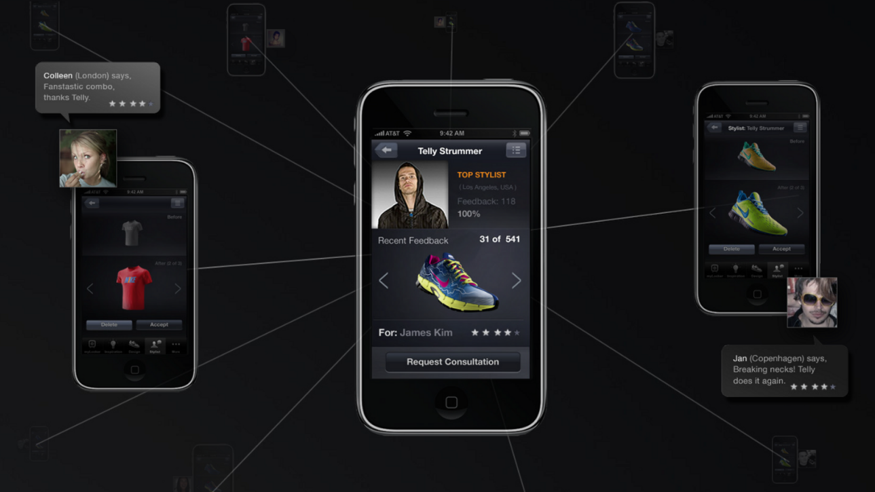
Proposed IT Solution:
Enhanced Custom Sneaker Design and Manufacturing System (ECSDMS)
1. Advanced 3D Design Interface:
Create an advanced 3D design interface that provides customers with a highly realistic representation of their customized sneakers. This tool should allow users to interact with their design in real-time, providing detailed visualizations of color choices, materials, patterns, and even the placement of personalized elements.
2. Augmented Reality (AR) Sneaker Try-On:
Integrate augmented reality (AR) technology to offer customers a virtual "try-on" experience for their custom-designed sneakers. By using their smartphones, customers can see how the sneakers will look on their feet, considering design elements like color, pattern, and fit before finalizing their order.
3. AI-Powered Design Guidance:
Incorporate an AI-powered design assistant that offers personalized design suggestions based on customers' preferences. The AI could analyze popular design trends and recommend complementary color combinations and design choices, aiding customers in creating visually appealing and cohesive designs.
4. Smart Manufacturing and Tracking:
Implement IoT devices and sensors within the manufacturing process to track the progress of each custom sneaker in real-time. This technology enables efficient allocation of resources, optimization of production schedules, and the ability to address any potential delays promptly.

Slide 17
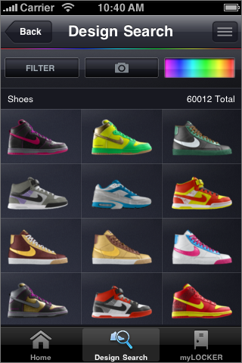
Benefits:
Enhanced Design Experience: The advanced 3D design interface and AR try-on feature offer customers a detailed and immersive design process, reducing discrepancies between their vision and the final product.
Guided Design Choices: The AI-powered design guidance assists customers in making design decisions, resulting in more aesthetically pleasing and trendy custom sneakers.
Efficient Production: IoT-enabled smart manufacturing and real-time tracking optimize production efficiency and minimize potential delays.
Quality Control: The AI quality assurance system contributes to consistent product quality and customer satisfaction.
Streamlined Customer Journey: A seamless design process, improved visualizations, and reliable delivery enhance the overall customer experience.

Slide 18
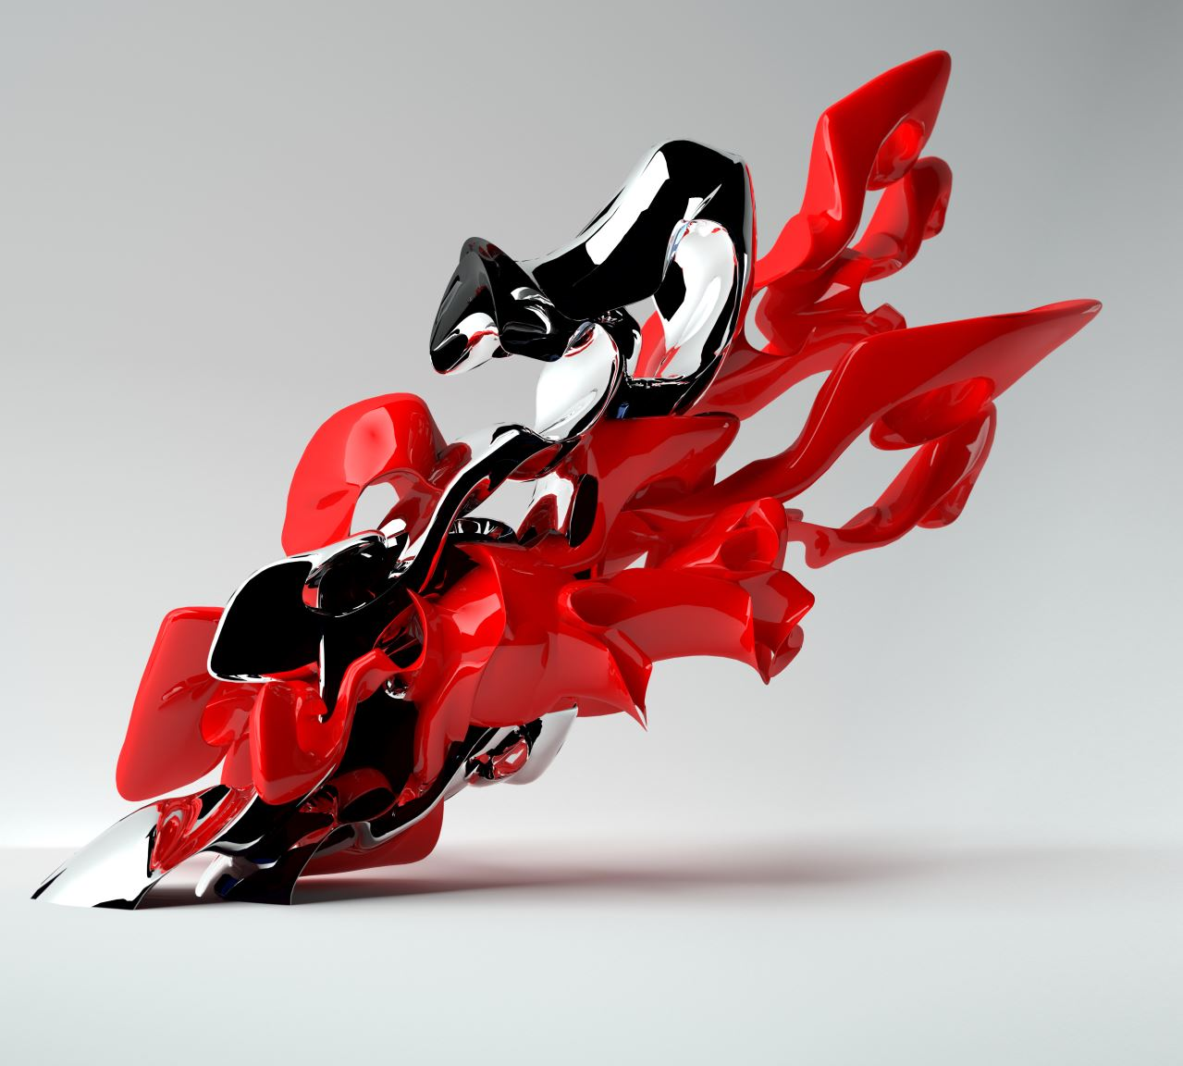
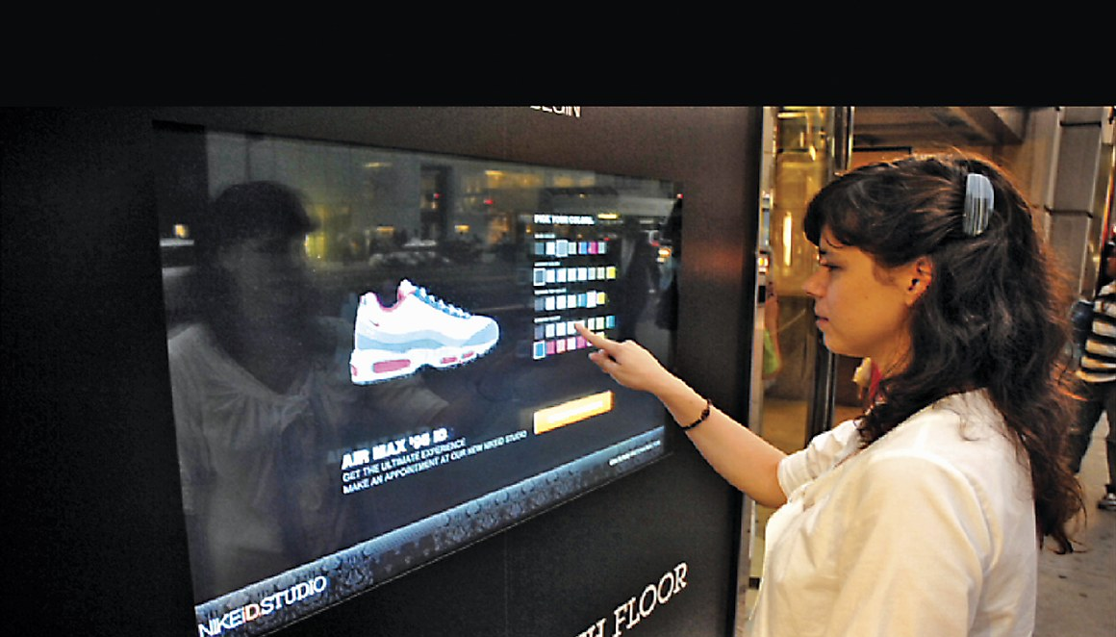
Delivering the Proposal:
Nike's Enhanced Custom Sneaker Design and Manufacturing System (ECSDMS) is poised to revolutionize the customization experience by addressing challenges in design accuracy, manufacturing efficiency, and quality control. With the implementation of advanced design tools, AR try-on capabilities, AI design assistance, smart manufacturing, and AI-driven quality assurance, ECSDMS stands as a solution that empowers Nike to offer custom sneakers that perfectly align with customers' visions. For further insights or a live demonstration of how ECSDMS can transform Nike's custom sneaker customization platform, please don't hesitate to contact us.

Slide 19
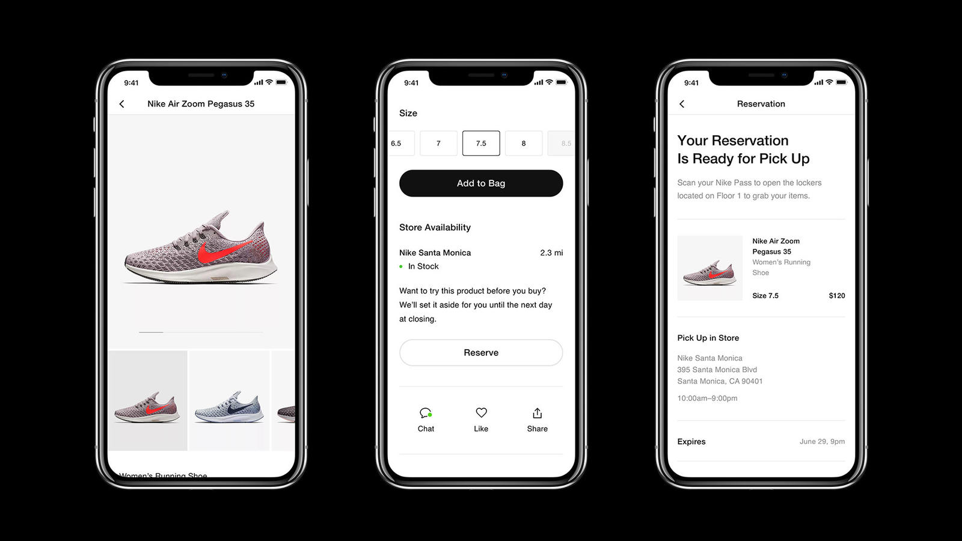
Background of the Proposal: Enhancing Nike's Custom Sneaker Design Experience
The background of this proposal centers around Nike's commitment to innovation, personalization, and elevating customer experiences within the footwear industry. Nike, a global leader in athletic footwear and apparel, has continuously strived to push boundaries and set new standards. In line with this ethos, the proposal aims to enhance Nike's custom sneaker design process through innovative IT solutions.
Rising Demand for Personalization: In recent years, there has been a notable shift in consumer preferences towards personalized products. Customers seek unique and customized options that align with their individual styles and preferences. Nike recognizes this trend and sees an opportunity to not only meet but exceed customer expectations by offering a superior custom sneaker design experience.
The Power of Technology and Innovation: Advancements in technology, including augmented reality (AR), artificial intelligence (AI), and Internet of Things (IoT), have opened new avenues for transforming the consumer experience. By harnessing the potential of these technologies, Nike aims to revolutionize how customers interact with their products and the brand.
Challenges in Customization: While custom sneaker design offers immense potential, there are challenges that need to be addressed. These challenges include accurate design communication, sizing precision, design visualization, and manufacturing transparency. Nike acknowledges the need for creative solutions to overcome these challenges and deliver a seamless and exceptional customization journey.
Vision for the Future: The proposal envisions a future where customers have the ability to fully immerse themselves in the custom sneaker design process. By seamlessly integrating cutting-edge technologies, Nike aims to empower customers to visualize, personalize, and experience their unique designs before they become a reality.

Slide 20
1. Market Research Insights:
1
Include data and insights from market research, highlighting the growing demand for personalized products and the competitive landscape in the custom sneaker industry.
2. Customer Feedback and Surveys:
2
Present feedback from customer surveys and focus groups, showcasing customer preferences, pain points, and expectations regarding custom sneaker design.
3. Case Studies and Success Stories:
3
Include case studies or success stories from other industries that have successfully implemented similar IT solutions to enhance customization and customer experiences.
4. Technology Partnerships:
4
Highlight potential technology partners or vendors that specialize in AR development, AI algorithms, IoT devices, and data analytics, emphasizing their expertise and credibility.
5. Implementation Timeline:
5
Provide a detailed timeline outlining the various phases of the project, including requirements gathering, design, development, testing, rollout, and ongoing improvements.
6. Budget Estimate:
6
Present a budget estimate that covers development costs, software licensing, hardware (IoT devices), AR app development, training materials, and potential marketing efforts.
Appendix: Additional Information on Nike's Custom Sneaker Design Enhancement

Slide 21




Thank you
Sejal singh
sejalsingh682@gmail.com

